Slide 1

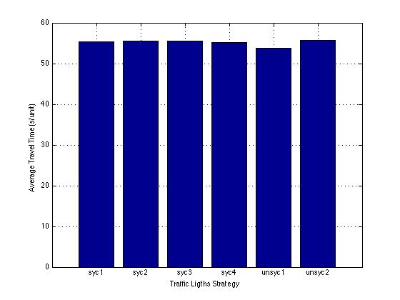
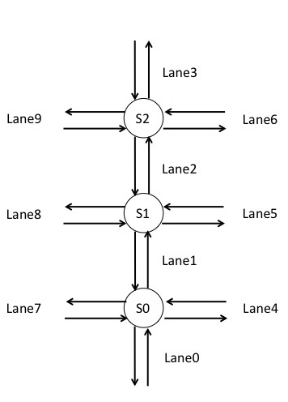
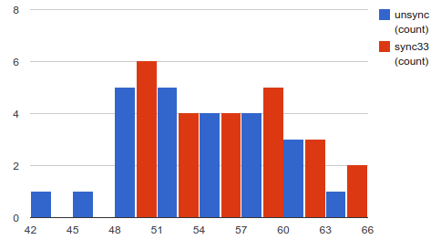
Peachtree Street Traffic Simulation
Rahul Nihalani, Yaohong Xi, Zangwan Cao
College of Computing, Georgia Institute of Technology
ABSTRACT
INTRODUCTION
SIMULATION MODEL
The goal of this simulation project is to compare the average travel time for vehicles to traverse a section of Peachtree Street in midtown Atlanta when using synchronized and to unsynchronized traffic signals. In both scenarios, each individual traffic signal will utilize a common timing pattern, that means the light remains red for R seconds, left turn green for L seconds, and green for G seconds, and repeats. In one case each of the lights operates independent of the others, the initial condition was set randomly. In the second case, we define different strategies so the lights are synchronized with each other to improve traffic flow (but use the same R-L-G timing as the unsynchronized case). We developed a Event Oriented Model to simulate a portion (from 10th to 14th street) of Peachtree Street during the afternoon commute.
The result of our simulation shows there is no significant difference between sync and unsync.
Our object for this project is to develop a simulation model to compare the average travel time for vehicles to traverse a portion of Peachtree Street (from 10th to 14th) when using synchronized compared to unsynchronized traffic signals. Traffic signal synchronization is a method of timing groups of traffic signals along an arterial to provide for the smooth movement of traffic with minimal stops. By calculating the arrival time for a group of vehicles at specific speed, we can time the traffic signals to turn green just as those vehicles arrive at each intersection.
A more realistic application for this project is we can optimize the travel process and come out with the most effective traffic light pattern to reduce the traffic congestion.
The NGSIM Dataset provides Peachtree Street Trajectory and Signal Time data. We can use it to get the geometric information about the Peachtree. Figure 1 shows the geometric structure of the study area. In this area, there are five intersections that divide the street into four sections.
Table 1. Traffic Light Strategies
The model map figure 2 shown below is a simplified version of peachtree street, which we simulate. The lane numbers and signal numbers are marked. Our model consists of four events, which are briefly described as follows:
1) EnterLane: EnterLane is called whenever a car tries to enter a lane. If the car is the first car in the lane (i.e. the lane was empty before that), it schedules SignalCheck for the front signals, which then remains active till the queue again becomes empty.
2) SignalCheck: It is fired by the first car in any lane, and then remains active for that lane till it becomes empty again. It's job is to see if the front car can pass to it's next lane. If yes, it schedules the entry and exit for that car by giving a delay t_d, which is the time a car takes to pass any intersection. If not, it schedules another SignalCheck after some wait.
3) ExitLane: Very similar to entry lane, it is called when a car wants to leave a lane
4) SignalChange: It is scheduled at times when the signals at an intersection need to be changed. It is called periodically.
Name | Description
syc1 | Diff between sig1 and sig2: 3 units, diff betwen sig2 and sig3: 3 units.
syc2 | Diff between sig1 and sig2: 2 units, diff betwen sig2 and sig3: 2 units.
syc3 | Diff between sig1 and sig2: 2 units, diff betwen sig2 and sig3: 4 units.
syc4 | Diff between sig1 and sig2: 0 units, diff betwen sig2 and sig3: 0 units.
unsyc1 | Diff between signals were set randomly.
unsyc2 | Diff between signals were set randomly.
RESULT & DISCUSSION
ASSUMPTION & SIMPLIFICARION
Our simulation results shows there is no significant difference between synchronized and unsynchronized scenarios. This result may be caused by the small size of our system. We only have three intersection here and number of vehicle coming into the system during the simulation time is also not huge.
Assumptions:
The distribution of vehicle on the minor roads is derived from the data of major road (the Peachtree Street). We lack this part of data, so we assume based on what we already have.
We treat them as unaggressive drivers, and then we induce no one will pass the cars before.
Entering time for each car, entering intersection for each car and exiting intersection for each car all obeys uniform distribution.
Simplification:
Each lane has unlimited capacity to hold vehicles.
There are two lanes on each side.
The traffic light has three states (red, left and green).
The car can start and stop immediately
There is no stop sign in each direction.
For all cars, the time for crossing each intersection is fixed (2 sec).
Time for cars driving on the lanes is ignored. We use travel time for each intersection to evaluate different scenarios.
The total car number in our system is a constant.
Chart 1. Model Result.
CONCLUSIONS
Figure 1. Model Map
Char 2.Tthe number of cars falling into the timing catagory

